Slide 1


Team 20: 3-Phase Matrix Converter
Bi-Weekly Update 2 Chase Barnes, Daniel Loeza, Shanelle Algama Sponsor: Dr. John Lusher TA: Rhett Guthrie
Notes:
Michelle

Slide 2
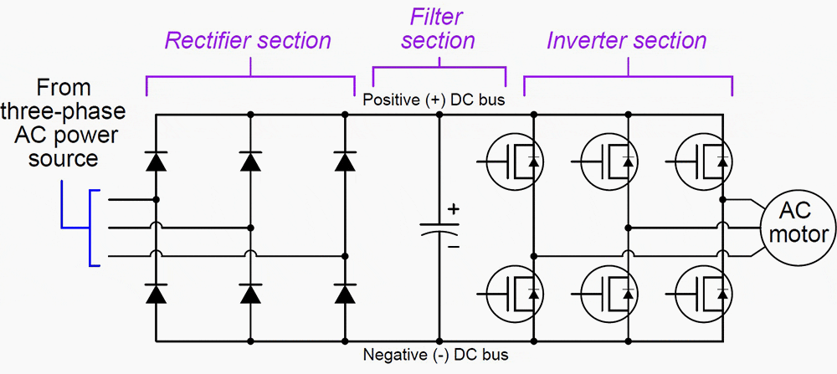
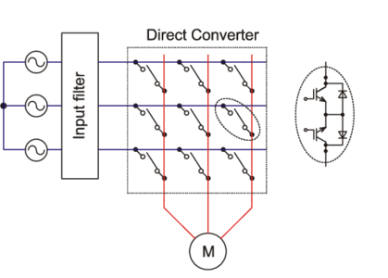
Project Summary
Traditional Variable Frequency Drives utilizes AC-DC-AC conversion:
Decreased efficiency across power output, and increased harmonic distortion.
3 Phase Matrix Converter utilizes AC-AC conversion:
Reduced efficiency loss across components.
Notes:
Barnes

Slide 3
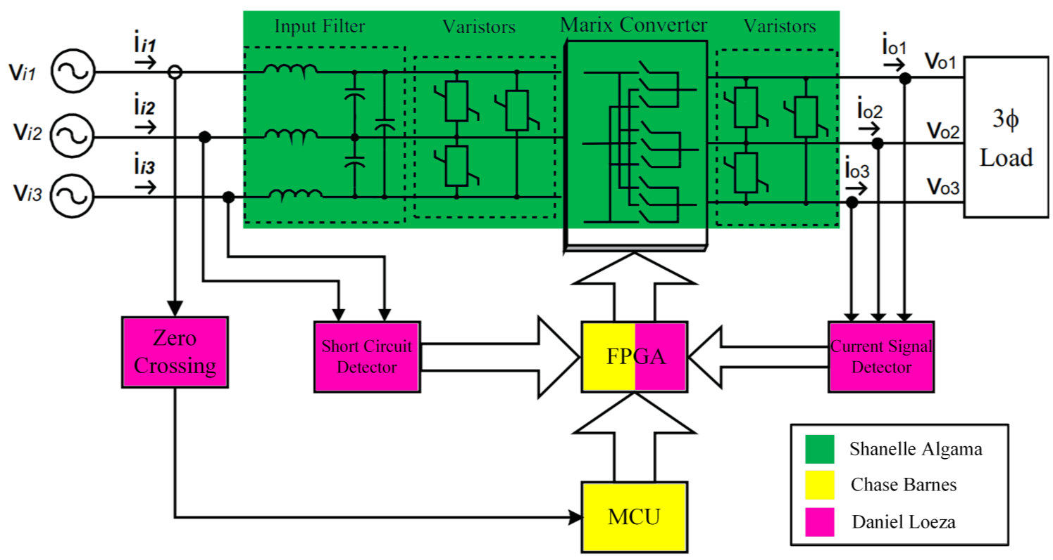
Project/Subsystem Overview
Bidirectional Switch subsystem
Creation of bidirectional switches with associated input filtration
Pulse Generator subsystem
Control board for sensing and communication to bidirectional switches
Firmware subsystem
Software for microcontroller, FPGA

Slide 4
Project Timeline
September 19 - Pulse Generator will be assembled
September 19 - System Integration will begin
September 30 - Firmware will be integrated with the Pulse Generator
September 30 - Full Matrix of Bidirectional Switches will be assembled
October 7 - Pulse Generator and Matrix Converter Subsystems will be validated and functional
October 14 - Full System Validation will begin
November 11 - System will be validated and functional
November 21 - Final Demo
Notes:
Eric

Slide 5
Firmware Subsystem
Chase Barnes
Accomplishments since last update 8 hrs of effort | Ongoing progress/problems and plans until the next presentation
MC Asynchronous Communication Fully Functional FPGA ADC Validated | Completing refactoring for target chips for board integration MC SVM Validation

Slide 6
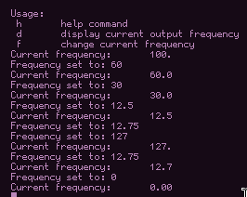
Firmware Subsystem
Chase Barnes
Async Uart Functionality
No additional figures for refactoring

Slide 7
Matrix Converter Subsystem
Shanelle Algama
Accomplishments since last update 15 hrs of effort | Ongoing progress/problems and plans until the next presentation
Finished selecting and ordering all new components Finished redesign of the bidirectional switch schematic and PCB and ordered it Completed schematic and PCB of the input filter board for integration Completed schematic and PCB of the output board (overvoltage protection and current signal detector connectors) for the motor | Upon receiving the boards, I will complete soldering of an isolated bidirectional switch board Validation process of the isolated bidirectional switch board will begin Solder and assemble the Input Filter board and Output board

Slide 8
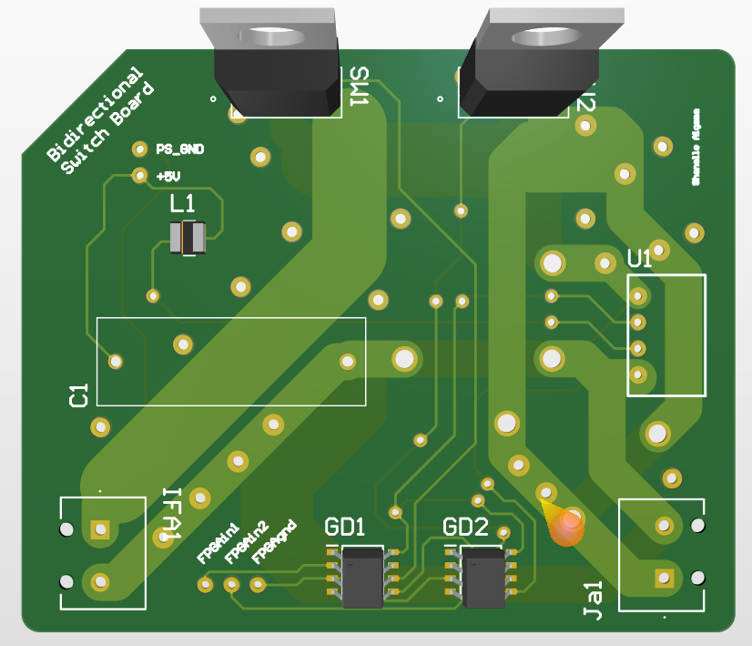
Matrix Converter Subsystem
Shanelle Algama

Slide 9
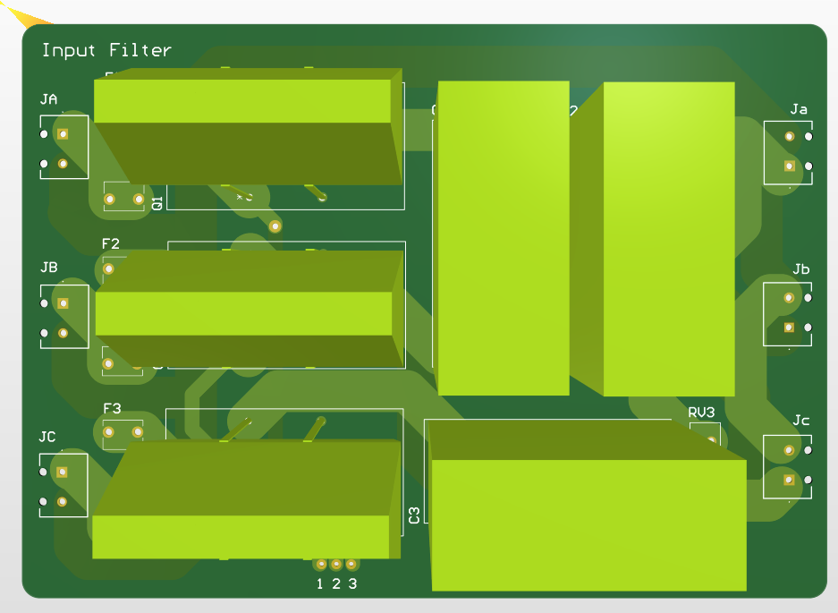
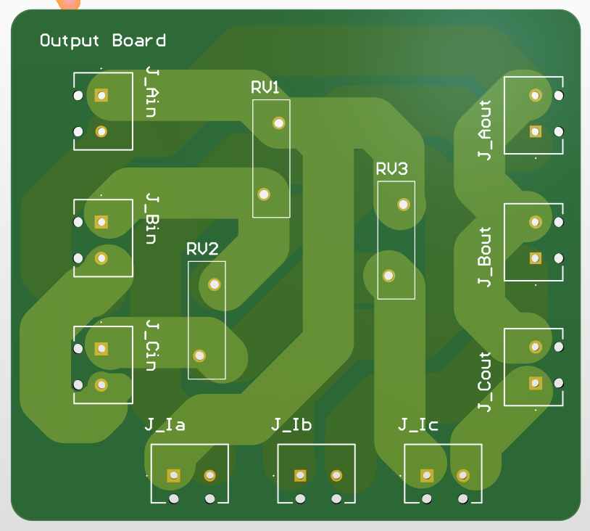
Matrix Converter Subsystem
Shanelle Algama

Slide 10
Pulse Generator Subsystem
Daniel Loeza
Accomplishments since last update 10 hrs of effort | Ongoing progress/problems and plans until the next presentation
Finishing touches on PCB (resizing, cleaning up, etc.) New components have been ordered | Begin and complete soldering components onto board (by end of this week's lab) Begin integration with the Firmware subsystem.

Slide 11
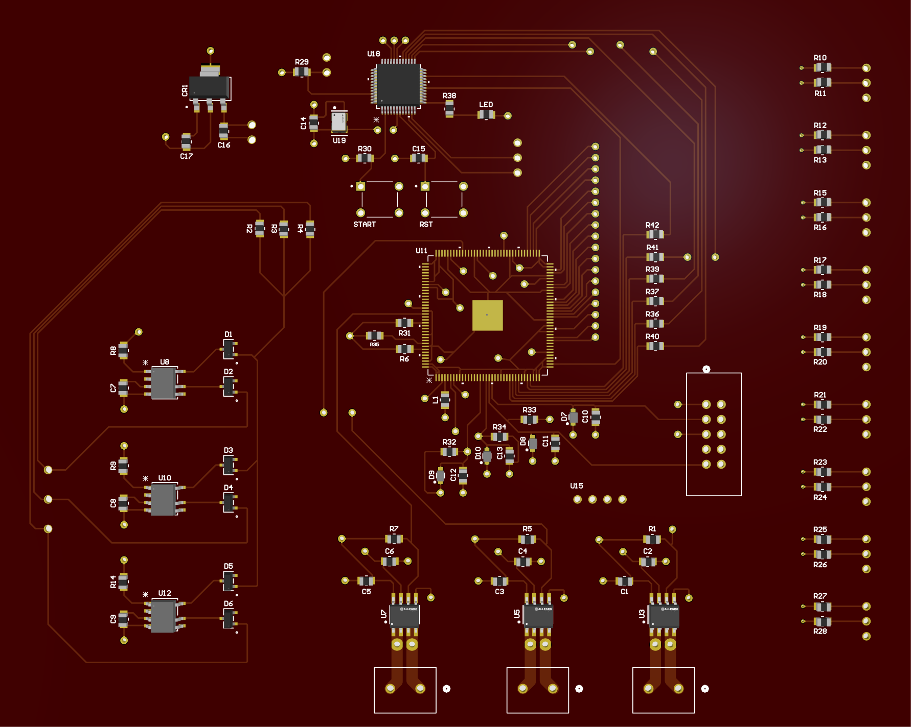
Pulse Generator Subsystem
Daniel Loeza

Slide 12
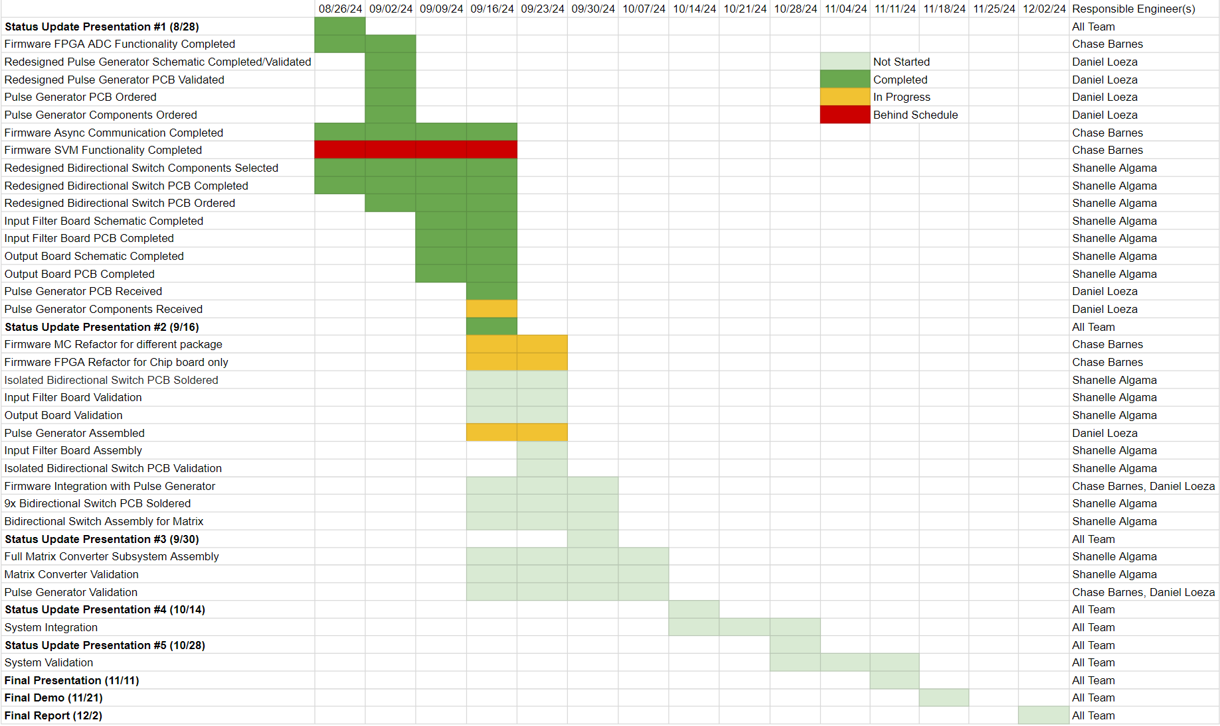
Execution & Plan
Notes:
Michelle

Slide 13
Thanks, and Gig ‘em!

